Slide 1
Feature Extraction

Slide 2
Suppose you have the image of cat
A computer doesn't naturally understand:
"This is a cat."
It sees numbers (pixel values).
So we try to extract important information/features from the image.
Examples of features:
Edges
Corners
Shapes
Texture
Color
Keypoints

Slide 3
What is an Edge?
An edge is a place where the image intensity changes significantly.
Consider this very simple image:
Black Black Black Black White White White White
0 0 0 0 255 255 255 255
There is a big change here:
That location is an edge.

Slide 4
Why do we need edges?
Edges help us identify:
Object boundaries
Shapes
Lines
Corners
Text boundaries

Slide 5
How does a computer know where an edge is?
It looks at changes in intensity.
Consider:
Pixel values:
10 10 10 10 200 200 200
Difference:
10 → 10 → 10 → 10 → 200
↑
BIG CHANGE

Slide 6
Three edge detection methods
Canny Edge Detection
LOG
DOG

Slide 7
LoG = Laplacian of Gaussian
It is an edge detection technique.
First smooth the image to remove noise, then find rapid intensity changes using the Laplacian.
Suppose you have this simple image:
BLACK BLACK BLACK BLACK WHITE WHITE WHITE
0 0 0 0 255 255 255

Slide 8
There is a sudden change:
0-255
That is an edge.
The problem is that real images contain noise.
For example:
10 11 9 12 200 198 201
Those small changes:

Slide 9
10 → 11
11 → 9
9 → 12
can also look like edges to an edge detector.
So LoG says:
"Let's blur the image first, then detect the edges.“
The Laplacian detects rapid changes in intensity.

Slide 10
It is based on the second derivative.
You may remember from mathematics:
First derivative tells us "How quickly is something changing?“
Second derivative
Tells us:
"How is that change itself changing?"
In image processing, the Laplacian uses second-order derivatives to identify regions where image intensity changes sharply.

Slide 11
First derivative
First derivative asks:
"How quickly is the image brightness changing?“
Black → Gray → White
Brightness is increasing, so the first derivative detects that change.

Slide 12
Second derivative
Second derivative asks:
"Is the rate of change increasing or decreasing?"
Think about a car:
Speed = how fast you're moving
Acceleration = how quickly your speed is changing

Slide 13
Similarly:
First derivative = how quickly brightness changes
Second derivative = how quickly that change is changing
S uppose brightness changes like this:
Dark Gray Bright
0 100 200
└───────────┴──────────┘
brightness changes

Slide 14
The Laplacian looks at the second derivative of this brightness.
BLACK BLACK BLACK | WHITE WHITE WHITE
0 0 0 | 255 255 255
↑
EDGE
Here brightness suddenly changes:
0 → 255
So first derivative says:
"There is a big change here!"

Slide 15
Second derivative
Now it asks:
"How is that change changing?"
The first derivative goes something like:
0 → BIG → 0
The second derivative looks at this change
The second derivative looks at this change and crosses 0 around the edge.

Slide 16
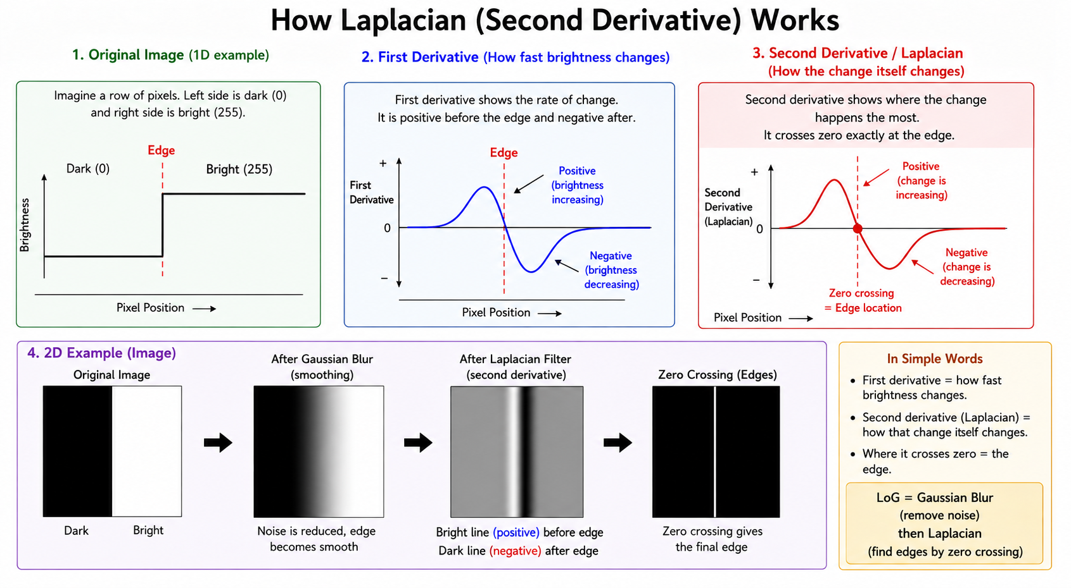
That zero crossing helps us locate the edge.

Slide 17
Let's use a simple example.
Suppose intensity is:
0 0 0 0 255 255 255 255
The transition from: 0→ 255
is very sudden.
The Laplacian responds strongly around this transition.

Slide 18
What is DoG?
DoG = Difference of Gaussians
The idea is very simple:
Blur the same image two different amounts, then subtract the two blurred images.

Slide 19
Line Detection using Hough Transform
The Hough Transform is a technique used in image processing to find straight lines in an image.
For example, if you have an image of a road:
The Hough Transform can detect the two straight road boundaries.
1. First, we need an image
Suppose we have road image We want to find the straight lines.

Slide 20
2. Find the edges
Usually, we first use an edge detector such as Canny.
It changes the image into something like:
The white pixels are the edge pixels.
Each white pixel has a coordinate:
For example, one edge pixel might be:
(x, y) = (2, 1)

Slide 21
Another:
(x, y) = (2, 2)
Another:
(x, y) = (2, 3)
Then Hough Transform uses these points
It takes:
(2,1)
(2,2)
(2,3)
...

Slide 22
and asks:
"Can these points belong to a straight line?"
If many points agree on the same line, Hough Transform detects that line.
So remember:
Canny finds the edge pixels → Hough Transform uses those edge pixels to find straight lines.

Slide 23
3. What does Hough Transform do?
The basic idea is:
Each edge pixel votes for possible lines that could pass through it.
Imagine we have one edge point:
There are many different lines that could pass through this point:
So that point gives votes to all those possible lines.

Slide 24
4. What happens with many edge points?
Suppose we have
Each point votes for possible lines.
Because these points are actually on the same line, their votes will agree on one particular line.
So that line gets many votes.
points that belong to the same straight line:
The Hough Transform says:
"A line with many votes is probably a real line in the image."

Slide 25
5. How does it represent a line?
Normally, we might write a line as:
y = mx + c
But this causes a problem with vertical lines, because their slope is infinite.
So Hough Transform usually uses:
ρ = x cos θ + y sin θ
It simply gives us a way to describe any straight line using two values:

Slide 26
ρ → distance of the line from the origin
θ → angle of the line
Line = (ρ, θ)
What is ρ?
ρ tells us how far the line is from (0,0).
The shortest distance from the origin to the line is ρ.
θ tells us the orientation/angle of the line's perpendicular direction.

Slide 27
The voting process
This is the most important part of the Hough Transform.
Suppose we have these edge points:
For every point, the algorithm tries many possible θ values.
For each θ, it calculates:
Each result is basically a vote for a particular line.

Slide 28
Line A → 2 votes
Line B → 3 votes
Line C → 50 votes ← strong line
Line D → 1 vote
The line with many votes is selected.
Where are the votes stored?
The votes are stored in something called an Accumulator.

Slide 29
Line | Votes
Line A | 2
Line B | 5
Line C | 50
Line D | 1

Slide 30
The highest number means:
"Many edge points agree that this line exists."
Parameter | Simple meaning
edges | Image containing edge pixels
1 | Distance precision
np.pi/180 | Angle precision = 1°
50 | Minimum votes
minLineLength=50 | Minimum line length
maxLineGap=10 | Maximum gap allowed

Slide 31
50 votes → how strong the line must be50 pixels → how long the line must be10 pixels → how big a gap can be
x1, y1, x2, y2 = line[0]
HoughLinesP gives a line like:
[[100, 50, 300, 200]]
line[0] removes the extra [] and gives:
[100, 50, 300, 200]

Slide 32
Then Python separates them:
x1 = 100
y1 = 50
x2 = 300
y2 = 200
These are two points:
Point 1 = (x1, y1)
Point 2 = (x2, y2)

Slide 33
(100, 50) ─────────── (300, 200)
↑ ↑
Point 1 Point 2

Slide 34
Exmaple:
Step 1: Canny finds the edge pixels
Canny looks for places where the brightness changes.
Your black line is surrounded by white, so Canny finds its boundary.
...............*
.............*
...........*
.........*
.......*
.....*
...*
.*

Slide 35
Each * has a coordinate:
Step 2: Hough looks at these points
Hough takes the edge points one by one.
Suppose it takes:
Point = (100, 50)
The algorithm asks:
"What straight lines could pass through this point?"
There are many possibilities:

Slide 36
So this point contributes votes to possible lines.
Step 3: It does the same for another point
Point = (110, 60)
Again, it asks:
"What lines could pass through this point?"
And another point:
Again, it votes.

Slide 37
Possible line A → 5 votes
Possible line B → 8 votes
Possible line C → 70 votes
Possible line D → 3 votes
The line with lots of votes becomes a strong candidate.
The 50 is the vote threshold.
Basically:
"I want enough evidence before I call something a line."

Slide 38
What is a corner?
A corner is a point where the image changes strongly in two directions.
──────────
|
|
|
|

Slide 39
The point where the horizontal and vertical lines meet is a corner:
Why do we detect corners?
Suppose you take two pictures of the same object:
If we can find the same corner in both images, we can understand that:
This point in Image 1 corresponds to this point in Image 2."

Slide 40
This is useful for:
Object recognition
Image matching
Tracking
Panorama creation
Camera motion estimation
3D reconstruction

Slide 41
Harris Corner Detector
The Harris Corner Detector is a method for finding corners.
Its basic idea is very simple:
Move a small window around the image and see how much the image changes.
Harris looks in different directions
Imagine we have three types of areas.

Slide 42
Suppose you have a black hexagon on a white background.
At a straight edge, intensity changes mainly in one direction.
At a corner, intensity changes in two directions.
Calculate image gradients
Harris first calculates how quickly intensity changes in the x and y directions.

Slide 43
Usually Sobel filters are used:
Ix​=∂I/∂x
​ Iy​=∂I/∂y
So for every pixel, we get:
Ix​ → horizontal intensity change
Iy​ → vertical intensity change
​

Slide 44
Flat region Edge Corner
0 0 0 0 0 255 0 0 255
0 0 0 0 0 255 0 255 255
0 0 0 0 0 255 255 255 255
small strong strong in
change change 2 directions

Slide 45
Calculate gradient products
Harris calculates:
Ix^2​,Iy^2​,Ix​Iy​
Then it considers a small neighborhood around every pixel.
For example, a 3×3 window:
It sums/averages the gradient information inside this window.

Slide 46
Suppose after applying Sobel filters, for a particular pixel we get:
Ix​=10 Iy​=5
hen:
1. Calculate Ix2​
Ix2​=102=100
2. Calculate Iy2​
Iy2​=52=25
3. Calculate Ix​Iy​
Ix​Iy​=10×5=50

Slide 47
Value | Result
(I_x) | 10
(I_y) | 5
(I_x^2) | 100
(I_y^2) | 25
(I_xI_y) | 50

Slide 48
1 2 3
4 5 6
7 8 9
-1 0 1
2 0 2
-1 0 -1

Slide 49

Why do we calculate these three values?
Because Harris needs to understand how much the image changes around a pixel in different directions.
The three values are later used to create the matrix:

Slide 50
But notice the Σ (summation).
We don't normally use just one pixel. We look at a small neighborhood, such as a 3×3 window.
Let's calculate a complete 3×3 example

Slide 51
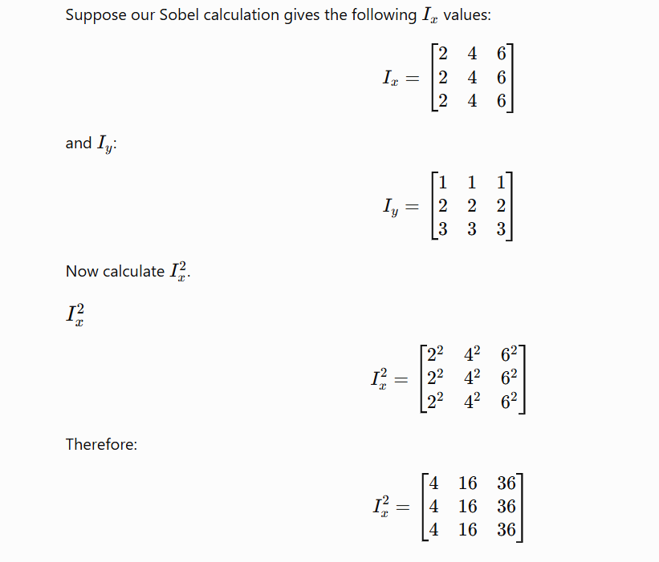

Slide 52
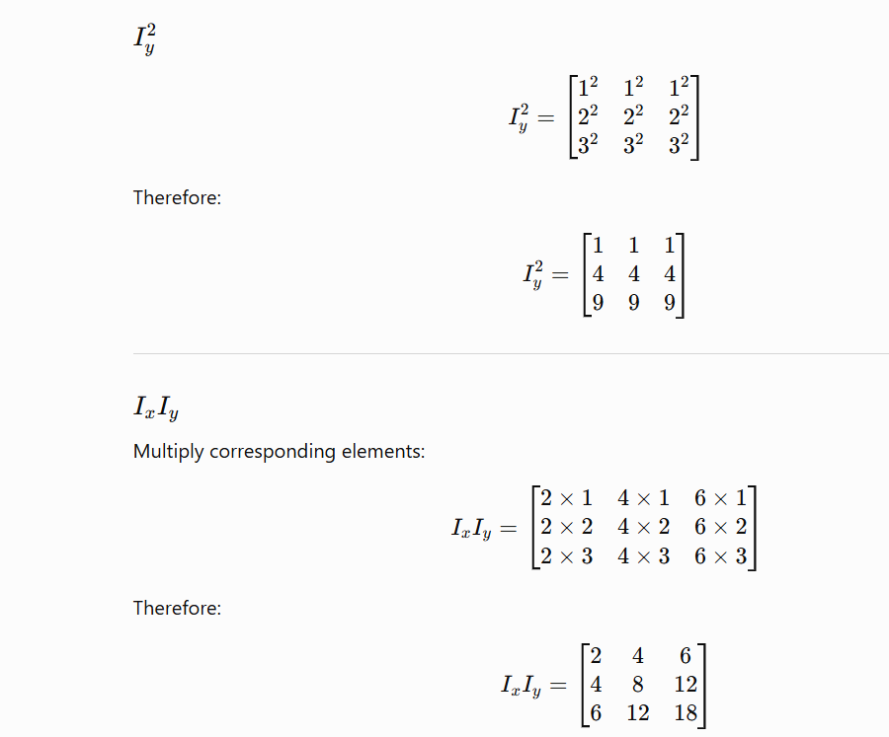

Slide 53
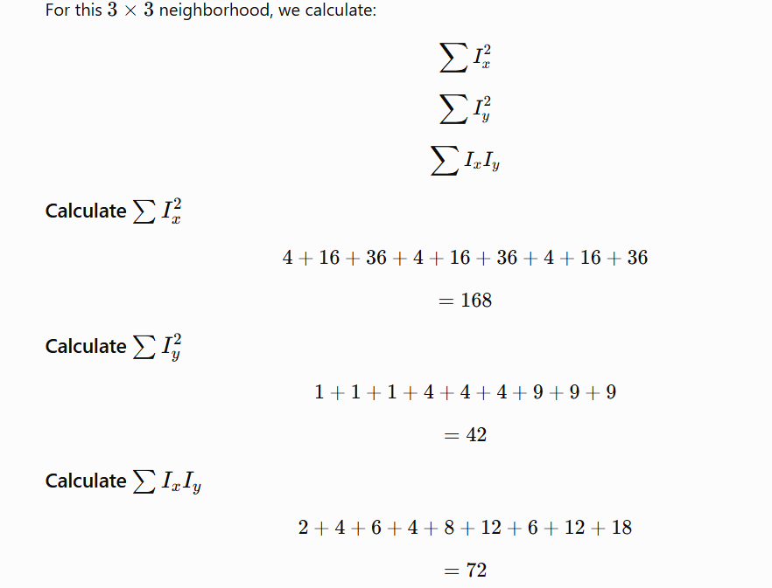
Now comes the important part: summation

Slide 54
So we now have:
∑Ix2​=168
∑Iy2​=42
∑Ix​Iy​=72
Now construct the Harris matrix

Slide 55
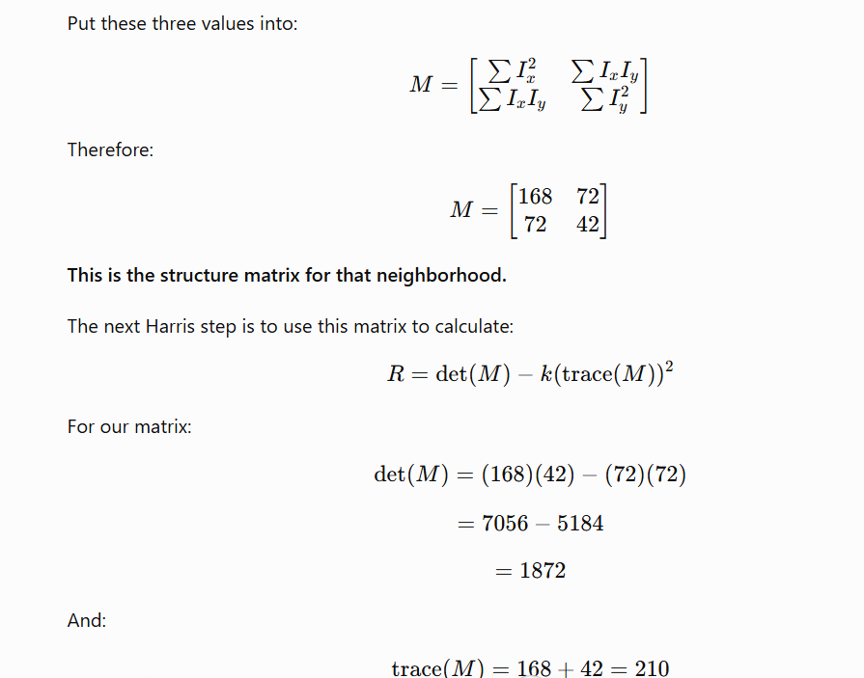

Slide 56
Since the Harris response is positive and relatively strong, this location could be considered a corner candidate.

Slide 57
Flat area
Move the window: right
Not much changes.
Move it: down Again, not much changes.
So:
Not a corner.

Slide 58
Edge: If we move along the edge(right): not much changes.
But if we move across the edge: in down a lot changes.
So:
This is an edge, not a corner.

Slide 59
Now move the window horizontally: Big change.
Move it vertically:Big change in both directions = corner.
This is the main idea behind Harris.

Slide 60
Harris finds a corner by checking whether the image changes strongly when we move a small window in different directions.
What does Harris actually calculate?
Harris calculates something called the Harris response.
You may see this formula:
R=det(M)−k(trace(M))^2

Slide 61
M is called the structure tensor or second-moment matrix.
It contains information about how much the image changes in the x and y directions.
Understanding the Harris response
The result R tells us what kind of point we have.
Flat region R ≈ small
Edge R = negative / relatively low
Corner R = large positive
Strong change in two directions.

Slide 62
Flat → small response
Edge → low/negative response
Corner → high positive response
Suppose we have this matrix
M=[4 1
1 3 ]

Slide 63
What is det(M)?
det = determinant
he determinant is:
det(M)=(a×d)−(b×c)
det(M)=(4×3)−(1×1) =12−1 det(M)=11​

Slide 64
So det just gives us one number from the matrix.
What is trace(M)?
Trace = add the numbers on the main diagonal.
Our matrix:
[4​1​
13​​]
Diagonal are 4 and 3 so add4+3=7
So trace=7

Slide 65
k is simply a small constant number used by Harris.
sually:
k=0.04
You don't calculate k.
We choose it.
det(M) = 11trace(M) = 7k = 0.04
So, finally R=9.04

Slide 66
R is the Harris corner score.
It tells us how much the point looks like a corner.
R = 9.04 → strong positive score → likely a corner
Small R → probably flat
Negative R → probably edge
Large positive R → probably corner

Slide 67
Code
gray
↓
The image we want to check
2
↓
Look at a small 2×2 area
3
↓
Size of the Sobel filter
0.04
↓
k value used in Harris

Slide 68
cornerHarris() finds corners and gives each pixel a corner score.
For example:
Pixel A → R = 0.1
Pixel B → R = 0.8 ← strong corner
Pixel C → R = 0.02

Slide 69
corners = cv2.dilate(corners, None)
This makes the detected corner areas bigger/thicker.
mage[corners > 0.01 * corners.max()] = [0, 0, 255]
corners.max()
Finds the largest corner score.
scores:
0.1
0.5
0.9 ← maximum
0.2

Slide 70
0.01 * corners.max()
If maximum = 0.9:
0.01 × 0.9 = 0.009
This becomes our threshold.
We're saying:
"Only show pixels whose corner score is strong enough."

Slide 71
0.1 > 0.009 → YES
0.5 > 0.009 → YES
0.001 > 0.009 → NO
Only keep corners whose score is greater than 1% of the strongest corner.“
0.01 * 100 = 1

Slide 72
Hessian-Affine
First, remember Harris:
Harris finds corners.
Hessian-Affine is a little different:
Hessian-Affine finds interesting parts/regions of an image that can still be recognized when the image changes.

Slide 73
What is an "interesting part"?
Imagine this picture of a face:
The eyes, nose, and mouth are interesting parts because they have lots of changes in brightness and shape.
A computer can use these parts to recognize the same face in another picture.

Slide 74
What if the picture becomes bigger?
The object became bigger.
A good feature detector should still be able to say:
This is the same feature."
Hessian-Affine is designed to help with this.

Slide 75
What if we rotate it?
The feature changed its orientation.
Hessian-Affine tries to find features that can still be matched.
What if we see it from the side?
Imagine a book.
Straight view:
Side/tilted view:
The shape looks different because of the viewpoint.
Hessian-Affine tries to find a region that is still recognizable.

Slide 76
Why is it called "Hessian"?
Because it uses the Hessian matrix, which uses second derivatives.
Why is it called "Affine"?
Affine basically means the image can change in certain ways, such as:
Size ↗
Rotation ↻
Stretching →
Tilt /

Slide 77
Suppose we have a small black object:
Step 1 — Look at brightness
The computer sees numbers instead of "black" and "white".
White = 255
Black = 0
So around the object:

Slide 78
255 255 255 255 255
255 255 0 255 255
255 0 0 0 255
255 255 0 255 255
255 255 255 255 255
The computer notices:
"The brightness changes a lot around this object."

Slide 79
Step 2 — Look for changes
The detector checks:
Horizontal direction →
255 → 0 → 255
Big change.
It also checks:
Vertical direction ↓
255
↓
0
↓
255

Slide 80
Again, big change.
So this region looks interesting.
Step 3 — Hessian uses second derivatives
You already learned:
First derivative = "How quickly is brightness changing?"
Second derivative = "How is that change itself changing?"

Slide 81
Hessian uses these second derivatives.
It basically checks:
Image
↓
Brightness changes
↓
Second derivatives
↓
Interesting region?

Slide 82
You don't need to manually calculate the derivatives. OpenCV/math libraries do that.
OpenCV calculates derivatives by looking at nearby pixels and comparing their brightness.
Suppose a row of pixels is:
100 100 100 200 200
OpenCV sees:
100 → 100 → 100 → 200 → 200

Slide 83
At the place where: 100 → 200
there is a big change.
That means there is an edge/change there.
OpenCV commonly uses a small filter called a Sobel kernel.
for example, a simple horizontal filter is:
[-1 0 +1]
It looks at 3 nearby pixels:

Slide 84
100 100 200
↓ ↓ ↓
-100 0 +200
Then roughly:
(-1 × 100) + (0 × 100) + (1 × 200)
= -100 + 0 + 200
= 100

Slide 85
So the result is 100, meaning there is a strong change.
For Hessian
Imagine this simple image
100 100 100
100 50 100
100 100 100

Slide 86
There is a dark pixel in the middle.
Hessian looks at the brightness changes around the middle.
Step 1: Hessian gets derivatives
It calculates:
Ixx → change in the X (left-right) direction
Iyy → change in the Y (up-down) direction
Ixy → how X and Y changes interact

Slide 87
Hessian creates this matrix:
H=[Ixx Ixy​
Ixy Iyy​]
Step 2: What does Hessian do with them?
It combines those derivative values to determine:
"Is there a strong image structure at this location?"

Slide 88
Flat area:
100 100 100
100 100 100
100 100 100
→ very little change
→ Hessian response is weak

Slide 89
100 100 100
100 50 100
100 100 100
→ strong change around the center
→ Hessian response is strong
So Hessian can identify an interesting region.

Slide 90
Step 3: Why second derivatives?
Imagine brightness like a hill:
The brightness changes as you move toward the center.
The first derivative tells:
"Is brightness going up or down?"
The second derivative tells:
"Is that change itself changing?"
Hessian uses this second-order information to find places with strong local structure, such as blobs and distinctive regions.

Slide 91
Hessian takes the second derivatives (Ixx, Iyy, Ixy) and combines them to measure how strongly the image changes around each pixel. Strong responses indicate interesting image structures.
hessian = cv2.xfeatures2d.HarrisLaplaceFeatureDetector_create()
Create the feature detector
This creates a Harris-Laplace feature detector.
It is used to find important points/features in an image.
For example, corners or distinctive regions.

Slide 92
How Hessian feature detection works
Take the image
  It looks at the brightness of neighboring pixels.
Calculate second derivatives
  It checks how quickly the brightness changes.
  This gives:
    Ixx​
    Iyy​
    Ixy​
Build the Hessian matrix
H=[Ixx​Ixy​​Ixy​Iyy​​] Calculate the Hessian determinant
det(H)=Ixx​Iyy​−Ixy^2​

Slide 93
If the determinant is strong, that location is likely to be a feature/keypoint.
Weak values are ignored.
keypoints = hessian.detect(img)
img is your input image.
detect() searches the image for important points.
The detected points are stored in keypoints.

Slide 94
100 100 100 100 100
100 100 100 100 100
100 100 255 100 100
100 100 100 100 100
100 100 100 100 100
The center pixel 255 is very different from its neighbors 100.

Slide 95
The Hessian detector checks the second-order change around every pixel.
Flat area → little change → not important
Edge → strong change mainly in one direction → usually weaker
Corner/blob → strong change in multiple directions → important
Check every region of this image and find locations where the intensity changes significantly in different directions.”

Slide 96
Those locations become the keypoints.
One important thing: the detector doesn't simply choose the brightest pixels. It chooses pixels/regions with a strong local structure/change, which makes them useful for recognizing the same object later.

Slide 97
Draw the detected points
drawKeypoints() draws the detected keypoints on the original image.
img → original image.
keypoints → points detected in step 2.
None → OpenCV creates the output image automatically.
DRAW_RICH_KEYPOINTS → draws the points with additional information such as size and orientation.

Slide 98
Orientation Histogram
In Computer Vision (CV), an Orientation Histogram is a way of describing an image region by counting which directions the edges/gradients point toward.
It is especially important in HOG (Histogram of Oriented Gradients), which is used for object detection and shape recognition.
Which direction the edges in an image are pointing.

Slide 99
For example, an image can have edges going:
→ Horizontal
↑ Vertical
↗ Diagonal
↘ Diagonal
The histogram simply counts how many strong edges point in each direction.

Slide 100
How does the computer find the direction?
For every pixel, it checks how much the brightness changes.
It calculates two things:
1. Gradient Magnitude
This tells:
How strong is the edge?
Small change → weak edge
Big change → strong edge

Slide 101
2. Gradient Orientation
This tells:
Which direction is the change happening?
For example:
→ 0°
↗ 45°
↑ 90°
↖ 135°

Slide 102
Small numerical example
Suppose we have 5 pixels:
Pixel | Direction | Strength
1 | 0° | 5
2 | 0° | 3
3 | 90° | 8
4 | 90° | 6
5 | 45° | 4

Slide 103
trength means how strong or clear the edge/change is.
In simple words:
Small brightness change → weak edge
Big brightness change → strong edge
Now we add the strengths for each direction.
0°: 5+3=8
45°: 4
90°: 8+6=14

Slide 104
The computer can now say:
90° has the strongest edges in this area.
Why is this useful?
Orientation histograms are very useful for recognizing shapes and objects.
For example, consider a person:

Slide 105
A person has many different edges:
Head → curved edges
Body → vertical edges
Arms → diagonal edges
Legs → diagonal/vertical edges
The orientation histogram captures these edge patterns.

Slide 106
This is why it is used in HOG (Histogram of Oriented Gradients).
Image
↓
Find edges
↓
Find edge directions
↓
Make histograms
↓
Use histograms to recognize the shape/object

Slide 107
Think of an image as numbers
10 10 10
10 100 100
10 100 100
Each number represents brightness:
0 = black
255 = white

Slide 108
Getting Gx​
Gx​ measures the change from left → right.
A very simple way is:
Gx​=right pixel−left pixel
10 100 100
↑ ↑
left right

Slide 109
For the middle pixel:
Gx​=100−10 Gx​=90​
That means there is a strong horizontal brightness change.
Getting Gy​
Gy​ measures the change from top → bottom.
For example:
10
|
100
|
100

Slide 110
For the middle pixel:
Gy​=100−10
Gy​=90​
So there is also a strong vertical brightness change.
In real Computer Vision
We normally don't just use:
right−left

Slide 111
Instead, OpenCV uses filters such as the Sobel operator.
Gx​ Sobel filter
Gy​ Sobel filter
x​=5,Gy​=0
Then:
θ=tan−1(0/5) θ=tan−1(0) θ=0 degree
So the gradient points straight horizontally →.
θ=45 degree it will be diagonal

Slide 112
Direction=tan−1(Gy​/Gx​)

Slide 113
SIFT
SIFT = Scale-Invariant Feature Transform
IFT finds interesting points in an image and describes what is around those points.
SIFT might find interesting points around:
corners
windows
edges
distinctive patterns
These points are called keypoints.

Slide 114
What is a keypoint?
A keypoint is simply an interesting location in an image.
How does SIFT work?
SIFT can be understood in roughly 4 main steps.
Step 1: Find important points
SIFT searches the image for locations that are different from their surroundings.

Slide 115
These become keypoints.
Image
↓
Find interesting locations
↓
Keypoints

Slide 116
Step 2: Make it work at different sizes
This is the Scale-Invariant part.
Suppose you have:
Small car
and:
Large car
SIFT tries to recognize the same feature even if the object appears at a different size.

Slide 117
This is useful when:
Object far away → small
Object nearby → large
SIFT uses multiple image scales to find features.
Step 3: Find orientation
SIFT also determines the direction around a keypoint.

Slide 118
The keypoint may have a particular dominant direction.
This helps SIFT handle image rotation.
Step 4: Create a descriptor
SIFT doesn't just say:
"There is a keypoint here."
It creates a descriptor that describes the area around the keypoint.

Slide 119
SIFT Practical
sift = cv2.SIFT_create()
This creates a SIFT object.
SIFT is an algorithm that finds interesting/important points in an image.
These points are called keypoints.
A keypoint might be located around:
A corner
An edge
A textured area
A distinctive pattern
A small object detail
The important thing is that these points should be recognizable even if the image changes in scale or rotation.

Slide 120
Find keypoints and descriptors
keypoints1, descriptors1 = sift.detectAndCompute(gray1, None)
keypoints2, descriptors2 = sift.detectAndCompute(gray2, None)
SIFT does two things here:
Finds keypoints
Creates descriptors for those keypoints

Slide 121
Keypoints
A keypoint is an interesting location in the image.
SIFT might find hundreds or thousands of these points.
The variable:
keypoints1
contains the keypoints from the first image.

Slide 122
What is a descriptor?
Finding a point isn't enough.
Suppose SIFT finds this point:
•
We need to know what the area around that point looks like.
That's where a descriptor comes in.
A descriptor is basically a numerical description of the appearance around a keypoint.

Slide 123
Imagine a person's fingerprint
A person has a location: Person → Rahul
But knowing the person's name/location isn't enough to recognize them.
We can use their fingerprint:
Rahul
↓
Fingerprint
↓
Unique pattern

Slide 124
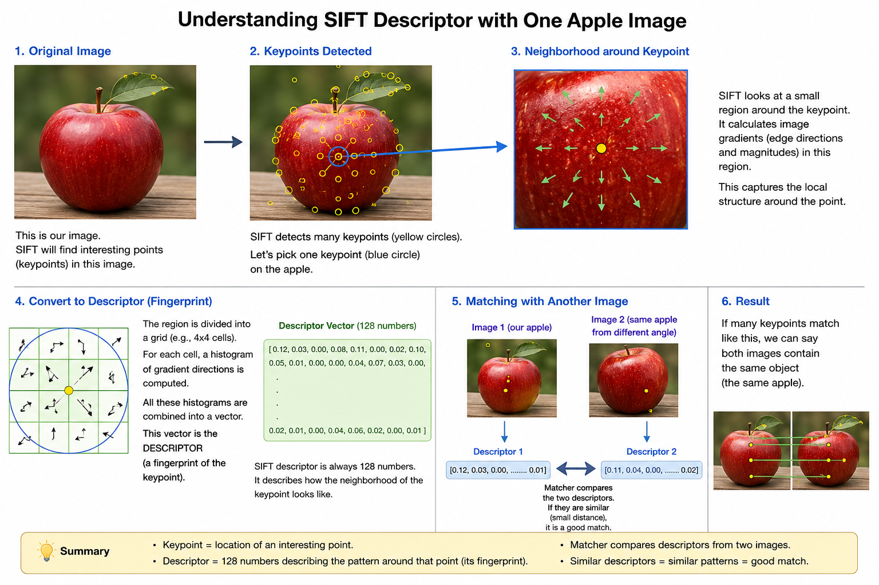

Slide 125
APPLE
↓
Choose a KEYPOINT ●
↓
Look at the area around ●
↓
Find brightness changes
↓
These changes create EDGES
↓
Measure their direction + strength
↓
These measurements are GRADIENTS
↓
Put the information into numbers
↓
128 numbers
↓
DESCRIPTOR

Slide 126
Edge = where brightness changes.
Gradient = how much and which direction brightness changes.
Descriptor = numerical summary of these patterns around a keypoint.

Slide 127
Create a Brute-Force Matcher
Brute-Force Matcher
Its job is to compare descriptors from the first image with descriptors from the second image.
Imagine image 1 has:
A1
A2
A3
A4
...

Slide 128
and image 2 has:
B1
B2
B3
B4
...

Slide 129
The matcher asks:
Does A1 look like B1?
Does A1 look like B2?
Does A1 look like B3?
...
Then:
Does A2 look like B1?
Does A2 look like B2?
...

Slide 130
That's why it is called brute force: it compares descriptors directly rather than using a more advanced search structure.
Find the two nearest matches
matches = bf.knnMatch( descriptors1, descriptors2, k=2)
knnMatch() means K-nearest-neighbor matching.
So for every descriptor in image 1, OpenCV finds its two closest descriptors in image 2.

Slide 131
Keep only good matches
good_matches = []
for m, n in matches:
if m.distance < 0.7 * n.distance:
good_matches.append(m)

Slide 132
This is called the Lowe's ratio test.
This is used to remove unreliable matches.
Suppose for one keypoint:
Best match distance = 20
Second-best distance = 80
The condition is:
20 < 0.7 × 80
which becomes:

Slide 133
20 < 56
That's true.
So we keep the match.
What does distance mean?
The descriptor consists of numbers.
The matcher compares two descriptors.
If they are very similar: small distance
If they are very different: large distance

Slide 134
The 0.7 controls how strict the test is.
A lower value generally makes the test stricter, producing fewer but potentially more reliable matches.

Slide 135
SURF = Speeded-Up Robust Features
Its basic job is also:
find important points → describe them → match them between images
First, what problem is SURF solving?
Suppose you have two photos of the same apple:
The camera may have moved.
The apple might be:
slightly bigger/smaller
rotated
moved to another position
viewed under somewhat different conditions

Slide 136
We want the computer to realize:
"These two images contain the same object."
SURF helps us do that.

Slide 137
SIFT | SURF
Scale-Invariant Feature Transform | Speeded-Up Robust Features
Uses Difference of Gaussians | Uses Hessian-based detector
Descriptor usually 128 values | Descriptor usually 64 values
Relatively computationally expensive | Designed to be faster
Uses image gradients | Uses Haar wavelet responses
Robust to scale/rotation | Robust to scale/rotation

Slide 138
IMAGE
│
↓
Find interesting points
│
↓
KEYPOINTS
│
↓
Describe each keypoint
│
↓
DESCRIPTORS
│
↓
Compare descriptors
│
↓
MATCHES

Slide 139
SIFT and SURF solve a similar problem, but they use different mathematics internally.
What does "Speeded-Up" mean?
This is one of the reasons SURF was created.
Imagine you have a large image:
2000 × 1500 pixels
There are millions of pixels.
If the algorithm performs expensive calculations everywhere, it can become slow.

Slide 140
SURF uses a clever technique called an:
Integral Image
This allows certain calculations to be performed much faster.
Integral Image — simple explanation
Suppose we have this tiny image:
1 2 3
4 5 6
7 8 9

Slide 141
Normally, if you want the sum of a rectangular region, you add the pixels individually.
SURF creates another representation called an integral image.
1 3 6
5 12 21
12 27 45
Each position represents the sum of pixels above and to the left.

Slide 142
1 + 2 + 4 + 5 = 12
So once this table has been created, rectangular sums can be calculated extremely quickly.
This is useful because SURF performs lots of rectangular filter operations.
SURF uses something called the:
Hessian matrix

Slide 143
SURF looks for places where the image changes strongly in multiple directions.
Mathematically, the Hessian matrix at a pixel looks like:
[ Ixx Ixy ]
H(x,y) = [ Ixy Iyy ]
where:
Ixx = second derivative in x direction
Iyy = second derivative in y direction
Ixy = mixed derivative

Slide 144
det(H) = Ixx × Iyy - Ixy²
A strong response indicates a potentially interesting feature.
Hessian matrix → tells SURF whether a location looks like a strong feature.
Why does SURF use a box filter?
Actually calculating Gaussian second derivatives can be expensive.
SURF approximates them using box filters.

Slide 145
And because SURF uses integral images, these box-filter calculations become very fast.
That's where the "Speeded Up" in SURF comes from.
SURF needs to handle different sizes
Suppose we photograph an apple.
The second apple is larger.
A good feature detector should still recognize corresponding points.
SURF therefore works across different scales.

Slide 146
Scale-Space
SURF creates different filter sizes rather than repeatedly creating expensive blurred images like SIFT.
It examines the Hessian response at these different scales.
If a feature produces a strong response at a particular scale, SURF can identify:
"This is an interesting feature at this size."

Slide 147
After finding a keypoint, SURF needs a descriptor
Now we arrive at the part you struggled with in SIFT.
SURF also needs a descriptor.
Remember:
Keypoint = WHERE
and
Descriptor = WHAT THE AREA AROUND IT LOOKS LIKE

Slide 148
Suppose SURF finds a point on an apple:
SURF looks at the neighborhood around that point.
It analyzes the local pattern.

Slide 149
nfeatures=0
This controls the maximum number of features SIFT keeps.
0 means:
Don't impose a maximum limit.
contrastThreshold=0.04
This controls how strong a feature must be before SIFT considers it useful.
Think about these two areas:

Slide 150
Strong feature: There is a strong difference between neighboring pixels.
Weak feature: There isn't much contrast.
SIFT tries to ignore weak/low-contrast points.
contrastThreshold=0.02 SIFT becomes more sensitive.
More keypoints
↓
More possible matches
↓
More noise/weak features

Slide 151
Higher value
contrastThreshold=0.08
SIFT becomes more selective.
Fewer keypoints
↓
Stronger features
↓
Potentially fewer matches

Slide 152
0.02 → many features
0.04 → normal/default-like setting
0.08 → fewer, stronger features
0.04 is a commonly used value.
edgeThreshold=10
This controls how SIFT handles features that look like edges.
SIFT generally prefers distinctive points such as corners and textured regions.
Consider a simple edge:

Slide 153
There is a strong edge, but not necessarily a distinctive point.
SIFT can reject features that are too much like edges because they may not be reliable for matching.
bigger value means less strict
more strict about rejecting edge-like features
edgeThreshold=10: standard/common value
edgeThreshold=20: allows more edge-like features
So increasing edgeThreshold generally results in more features being retained.

Slide 154
sigma=1.6 : This controls the amount of Gaussian smoothing used at the initial stage of SIFT.
You can think of it as controlling how much the image is blurred before SIFT looks for features.
Less smoothing:
More fine details
More small features
Potentially more noise

Slide 155
Larger sigma = 2.0
Less fine detail
More emphasis on larger structures
Less sensitivity to tiny noise
1.6 is the standard value used by SIFT's original formulation and is also OpenCV's default.
Find all useful features, reject very low-contrast features, don't be too strict about edge-like features, and use a standard amount of initial smoothing."

Slide 156
What is BFMatcher?
Image 1 Image 2
Descriptor 1 Descriptor 1
Descriptor 2 Descriptor 2
Descriptor 3 Descriptor 3
... ...
Descriptor 500 Descriptor 600

Slide 157
We want to find:
Which descriptor in Image 2 is most similar to each descriptor in Image 1?
The Brute-Force matcher does this by comparing descriptors against each other.
Image 1 Image 2
D1 ───────────────────→ D37
D2 ───────────────────→ D12
D3 ───────────────────→ D89
D4 ───────────────────→ D21

Slide 158
Why is it called "Brute Force"?
Suppose Image 1 has 500 descriptors and Image 2 has 600 descriptors.
The matcher can compare:500 × 600
That's:
300,000 comparisons
It essentially checks the possibilities and finds the closest ones.
That's why it's called brute force.
It's straightforward and often works well for smaller numbers of features

Slide 159
cv2.NORM_L2?
This tells OpenCV how to measure the distance between two descriptors.
means Euclidean distance.
A = [1, 2, 3]
B = [2, 4, 3]

Slide 160
The Euclidean distance is:
d=(1−2)2+(2−4)2+(3−3)2​
So:
d=1+4+0​ d=5​

Slide 161
Smaller distance means the descriptors are more similar.
Why do we use NORM_L2 for SIFT?
This is important.
SIFT produces floating-point descriptors, typically with 128 values.
SIFT descriptor:
[0.12, 0.53, 0.21, 0.87, ...]

Slide 162
For these descriptors, the appropriate standard distance metric is:
cv2.NORM_L2
So:
bf = cv2.BFMatcher(cv2.NORM_L2)
means:
Create a Brute-Force matcher and use Euclidean (L2) distance to compare SIFT descriptors.

Slide 163
good_matches = []
for pair in matches:
if len(pair) == 2:
m, n = pair
if m.distance < 0.7 * n.distance:
good_matches.append(m)

Slide 164
This part is used to remove bad/uncertain matches and keep only the reliable matches between your two images.
Normally, each pair should contain two matches.
m = best match
n = second-best match
Match 1 → distance = 40
Match 2 → distance = 100
0.7 × 100 = 70
40 < 70
That's True.
So the match is considered good.

Slide 165
80 < 70
That's False.
So we reject this match.
Feature Best 2nd Best Result
------------------------------------------------
1 30 100 GOOD
2 80 100 BAD
3 20 90 GOOD
4 70 80 BAD
5 25 100 GOOD

Slide 166
0.5 very strict
Fewer matches
Higher confidence
0.7 Good balance
0.9
More matches
But potentially more incorrect matches

Slide 167
What is GLOH?
GLOH = Gradient Location and Orientation Histogram.
Its purpose is:
Describe what a small region around an interesting point looks like, so that the same point can be recognized in another image.

Slide 168
Property | Meaning
kp.pt | (x,y) position
kp.size | Approximate scale/size of the feature
kp.angle | Orientation of the feature
kp.response | Strength/quality of the detected feature
kp.octave | Scale-space level where it was detected

Slide 169
Imagine the keypoint
x = 152
y = 87
For a grayscale image:
img[y, x]
row y
column x

Slide 170
Calculate the Y range
max(0, y-size)
y = 87
size = 16
max(0, 87-16)=71
The ending is:
y+size
87 + 16 = 103
So the Y range is:
71 : 103

Slide 171
Calculate the X range
max(0, x-size)
max(0, 152-16)=136
x+size=168
So the X range is:136 : 168
Therefore the final operation is
Your code is effectively doing:
patch = img[71:103, 136:168]

Slide 172
32 rows×32 columns
Why do we use max(0, ...)?
x = 5 y = 8
size = 16
x - size = 5 - 16 = -11
y - size = 8 - 16 = -8
We can't use negative image coordinates like that.
max(0, x-size)
max(0, -11) = 0

Slide 173
magnitude=gx^2+gy^2​
gx = 3
gy = 4
magnitude=3^2+4^2​ =9+16​ =5
So magnitude tells you how strong the edge/change is at that pixel.
Large magnitude → strong edge
Small magnitude → weak/no edge

Slide 174
cv2.phase(gx, gy)
This calculates the direction of the gradient.
angle=tan−1(gy/gx​)
angle=tan−1(4/3)
≈ 53.13°
magnitude = 5
angle = 53.13°

Slide 175
. Create 8 empty bins
[0, 0, 0, 0, 0, 0, 0, 0]
Box 0 → 0°–45°
Box 1 → 45°–90°
Box 2 → 90°–135°
Box 3 → 135°–180°
Box 4 → 180°–225°
Box 5 → 225°–270°
Box 6 → 270°–315°
Box 7 → 315°–360°

Slide 176
Now look at ONE pixel
direction = 70
mag = 5
Meaning:
Direction = 70°
Strength = 5
70° belongs to the 45°–90° range.
That's Box 1.

Slide 177
So we do:
histogram[1] += 5
[0, 5, 0, 0, 0, 0, 0, 0]
Look at another pixel
Suppose:
direction = 110
mag = 8
110° belongs to 90°–135°.
That's Box 2.

Slide 178
histogram[2] += 8
[0, 5, 8, 0, 0, 0, 0, 0]
Another pixel
Suppose:
direction = 75
mag = 3
75° also belongs to Box 1.
So:
histogram[1] += 3
Now:
[0, 8, 8, 0, 0, 0, 0, 0]

Slide 179
Because Box 1 already had 5, and we added 3.

Slide 180
Scale-Space Analysis
Scale-space analysis is one of the most important ideas behind SIFT, DoG, blob detection, and multi-scale feature detection.
The basic problem it solves is:
What if an object or feature appears at different sizes in an image?
For example, a corner may be very small in one image and much larger in another. A detector working at only one image scale may miss one of them

Slide 181
Imagine you have a picture of a car.
In one image, the car is very large:
In another image, the same car is far away:
t is the same object, but its size is different.
A computer vision algorithm needs to recognize features at both sizes.
That's why we use scale-space.

Slide 182
What is Scale-Space?
Scale-space means looking at the same image at different levels of detail.
We create several versions of the image.
Original
↓
Slightly blurred
↓
More blurred
↓
Very blurred

Slide 183
Why blur?
Because when we blur an image, small details disappear first, while large structures remain.
Small scale → see small details
Large scale → see large structures

Slide 184
What is an Image Pyramid?
An image pyramid is an easy way of making the image smaller and smaller.
For example, suppose your original image is:
800 × 600
We make:
Level 0 → 800 × 600
Level 1 → 400 × 300
Level 2 → 200 × 150
Level 3 → 100 × 75

Slide 185
It looks like a pyramid, so we call it an image pyramid.
How do we create it?
We don't simply make the image smaller.
We normally do:
Original image
↓
Gaussian Blur
↓
Reduce size
↓
New image

Slide 186
Then repeat:
Level 0
↓
Blur
↓
Reduce
↓
Level 1
↓
Blur
↓
Reduce
↓
Level 2

Slide 187
Why blur before reducing?
Suppose you have a detailed image:
If you immediately make it smaller, you can lose information incorrectly.
So first:
Original
↓
Blur
↓
Remove tiny details
↓
Make smaller
This gives a better smaller image.

Slide 188
Very simple example
Suppose you have a hexagon:
At the original size, you can clearly see the six corners.
Now make the image smaller:
The image is smaller, but the main shape is still there.
If you make it even smaller:
Some small details disappear, but the main structure remains.

Slide 189
Why is this useful in Computer Vision?
Suppose you are detecting a corner.
At one image scale:
small corner → difficult to detect
At another scale:
larger corner → easier to detect
So instead of checking only one version:

Slide 190
Image
↓
Harris
we can check multiple versions:
Image
↓
Pyramid
↓
├── Level 0 → Harris
├── Level 1 → Harris
├── Level 2 → Harris
└── Level 3 → Harris

Slide 191
Now we can find corners at different sizes.
Connection to SIFT
This is why SIFT is powerful.
Imagine you have: img1 small and img 2 big
SIFT looks at different scales and can find that these are corresponding features.
So:
Scale-space helps computer vision find the same feature even when its size changes.

Slide 192
cv2.circle(
img, # image
(150,150), # center
40, # radius
255, # color
3 # thickness
)

Slide 193
cv2.circle(img, (350, 350), 100, 255, 3)
Draw a large circle
This creates another circle:
Center = (350,350)
Radius = 100
White
Thickness = 3
Create the Image Pyramid

Slide 194
Level 0 → 500 × 500
↓
Level 1 → 250 × 250
↓
Level 2 → 125 × 125
↓
Level 3 → 63 × 63

Slide 195
What does pyrDown() actually do?
This is important.
It doesn't simply throw away every second pixel.
500 × 500
↓
Blur
↓
250 × 250

Slide 196
Now detect circles
Hough Circle Transform
circles = cv2.HoughCircles(
image,
cv2.HOUGH_GRADIENT,
dp=1,
minDist=20,
param1=100,
param2=20,
minRadius=5,
maxRadius=100
)

Slide 197
cv2.HOUGH_GRADIENT
This tells OpenCV which method to use for detecting circles.
Image → find edges → look for circular patterns → return circle centers + radii
dp controls the resolution of the internal accumulator used by the Hough algorithm.
Imagine your image is 1000 × 1000

Slide 198
dp = 1
Image: 1000 × 1000
Accumulator: 1000 × 1000
dp = 2
Image: 1000 × 1000
Accumulator: 500 × 500

Slide 199
dp | Accumulator | Effect
1 | Same resolution | More precise, more computation
2 | Half resolution | Faster, somewhat less precise
4 | Quarter resolution | Faster, less precise

Slide 200
minDist=20 This specifies the minimum distance between detected circle centers.
Circle 1 center → (150,150)
Circle 2 center → (152,151)
Circle 3 center → (149,150)
minDist=20 tells OpenCV not to accept circle centers that are too close to each other.

Slide 201
param1=100
This is related to edge detection inside the Hough Circle algorithm.
A higher value generally makes the edge detection more selective.
param1 controls one of the thresholds used for detecting edges.

Slide 202
gradient > 50 → strong edge
gradient < 25 → generally rejected
gradient 25–50 → potentially kept if connected to a strong edge
Important

Slide 203
param1 = 20 → easier to detect weak edges
param1 = 50 → medium threshold
param1 = 100 → requires stronger edges
param1 = 200 → requires very strong edges

Slide 204
Parameter | Controls | Think of it as
param1 | Edge detection | "Is this an edge?"
param2 | Circle detection | "Is this enough evidence for a circle?"

Slide 205
Param2 This controls how much evidence/votes are required before OpenCV accepts something as a circle.
Pixel values
↓
Gradient / edges
↓
param1 = 50
"Which pixels are edges?"
↓
Possible circles
↓
param2 = 20
"Does this have enough evidence to be a circle?"
↓
Circle detected

Slide 206
Circle candidate A → 50 votes
Circle candidate B → 25 votes
Circle candidate C → 15 votes
It means the circle candidate needs roughly 20 accumulator votes to pass the detection threshold.
A: 50 ≥ 20 →detected
B: 25 ≥ 20 → detected
C: 15 < 20 → rejected

Slide 207
minRadius=5,
maxRadius=100
Radius < 5 → ignore
5 to 100 → possible circle
Radius > 100 → ignore
Only look for circles whose radius is between 5 and 100 pixels.

Slide 208
for x, y, r in circles[0]:
x = center x-coordinate
y = center y-coordinate
r = radius
x = 120
y = 150
r = 40
circles[0] is used because HoughCircles() typically returns an array shaped like:

Slide 209
(1, number_of_circles, 3)
So circles[0] gives you the actual list of circles.
(1, 2, 3)
↑ ↑ ↑
│ │ └── x, y, radius
│ └───── 2 detected circles
└──────── 1 outer group
It become (2,3) by circle[0]

Slide 210
Gaussian derivative filters
Gaussian derivative filters are very important in image processing because they help us detect edges, lines, and changes in intensity while reducing noise.
First understand what a filter does
An image is basically a matrix of pixel values.
For example, a simple 1D image might look like:
10 10 10 10 10 200 200 200 200

Slide 211
There is a sudden change:
10 10 10 10 10 | 200 200 200 200
↑
edge
An edge occurs where pixel intensity changes rapidly.
So the question is:
How can we mathematically find where the image changes?
The answer is: derivatives.

Slide 212
What does a derivative mean?
In mathematics, a derivative tells us:
How quickly something is changing.
For example:
f(x) = x²
Its derivative is:
f'(x) = 2x

Slide 213
In image processing, we can think of:
x → position in image
f(x) → pixel intensity
So the derivative tells us:
How quickly pixel intensity changes as we move across the image.
That is exactly what we need for edge detection.

Slide 214
Simple example of an image derivative
Suppose pixel intensities are:
10 10 10 10 200 200 200 200
Calculate the approximate difference between neighboring pixels:
10 → 10 difference = 0
10 → 10 difference = 0
10 → 10 difference = 0
10 → 200 difference = 190 ← BIG CHANGE
200 → 200 difference = 0
200 → 200 difference = 0
200 → 200 difference = 0

Slide 215
So the derivative will be approximately:
0 0 0 190 0 0 0
The large value tells us:
There is an edge here.
But there is a problem: noise
Real images aren't perfectly clean.
Imagine:

Slide 216
10 12 9 11 10 200 198 201
There are small random changes:
10 → 12
12 → 9
9 → 11
A derivative sees those changes too.
So we might get:
+2 -3 +2 -1 +190 -2 +3

Slide 217
The real edge is +190, but there are also many small changes caused by noise.
This is where the Gaussian filter becomes useful.
What is a Gaussian filter?
A Gaussian filter is a smoothing filter.
It reduces small variations and noise

Slide 218
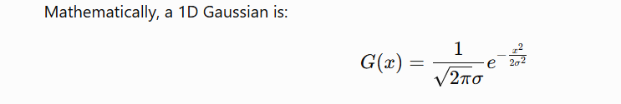

Slide 219
Gaussian filtering gives more importance to nearby pixels and less importance to distant pixels.
Example of Gaussian smoothing
Suppose we have:
10 10 12 9 11 200 198 201
Gaussian smoothing averages nearby pixels, but gives the center pixel more importance.

Slide 220
So instead of:
10 10 12 9 11 200 ...
we get something smoother, approximately:
10 10 11 11 50 160 195 ...
The exact values depend on the Gaussian's σ.

Slide 221
10 10 12 9 11 200 198 201
A Gaussian filter doesn't simply take the normal average. It gives more weight to the center and less weight to pixels farther away.
A simple Gaussian-like kernel could be:
1 2 1
---------
4
0.25 0.50 0.25

Slide 222
Apply it to one pixel
Take this section:
10 10 12
The center is 10.
10 × 0.25
+
10 × 0.50
+
12 × 0.25 =11

Slide 223
Now look near the large jump
Our original signal has:
10 11 200
There is a big jump between 11 and 200.
Apply the same kernel:
10 × 0.25
+
11 × 0.50
+
200 × 0.25 =58

Slide 224
Instead of:
11 → 200
you might get something like:
11 → 58 → 153 → 200

Slide 225
Now combine Gaussian + derivative
Here's the key idea.
We want to:
Remove noise
Find intensity changes

Slide 226
Image
↓
Gaussian filter
↓
Smoothed image
↓
Derivative
↓
Edges

Slide 227
This is called a Gaussian derivative filter.
But there is an even more useful mathematical property.
Instead of doing:
Gaussian → derivative
we can combine them into:
Derivative of Gaussian
This gives us a single filter.

Slide 228
Derivative of Gaussian
Suppose the Gaussian is:
G(x)
Its derivative is:
G′(x)
The derivative has positive and negative parts.

Slide 229
Why does it detect edges?
Consider an image with:
Dark region Bright region
10 10 10 10 | 200 200 200 200
↑
edge

Slide 230
When we apply the derivative of Gaussian:
What does a derivative do?
derivative basically asks:
"How quickly is this value changing?"
10 → 10
Change = 0
So derivative ≈ 0
But:
10 → 200

Slide 231
Change = 190
So derivative is large.
Slow/no change:
10 → 10 → 10 → 10
derivative ≈ 0
Sudden change:
10 → 10 → 200 → 200
↑
derivative = LARGE

Slide 232
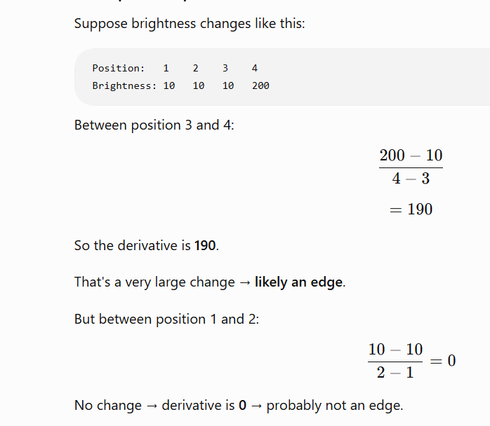

Slide 233
Why not just use the derivative?
Why don't we simply calculate the derivative?
Because derivatives amplify noise.

